Slide 1
Azure Functions
Serverless (it’s someone else’s server)

Slide 2
Serverless
FaaS
Function as a Service
Notes:
Compute runtime, most cloud providers offer a similar service.

Slide 3

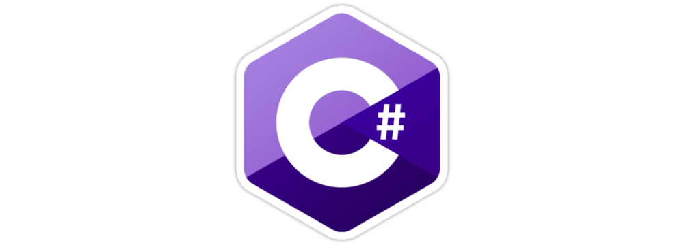


Languages
Notes:
C#, Java, F# and JavaScript
And more experimental languages.

Slide 4
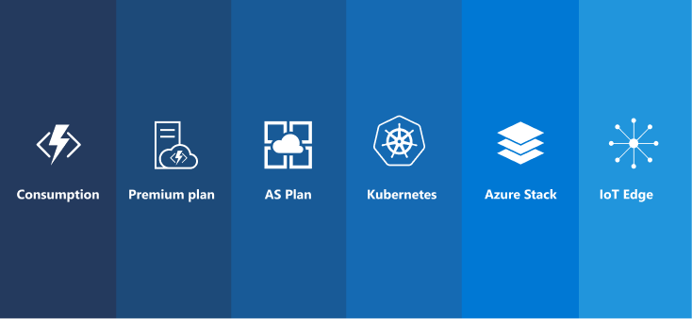
Hosting Options

Slide 5
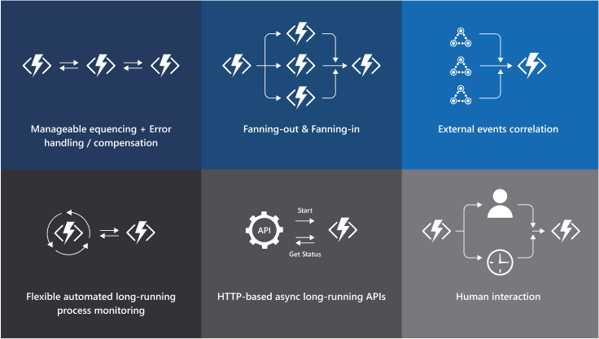
Scenarios

Slide 6
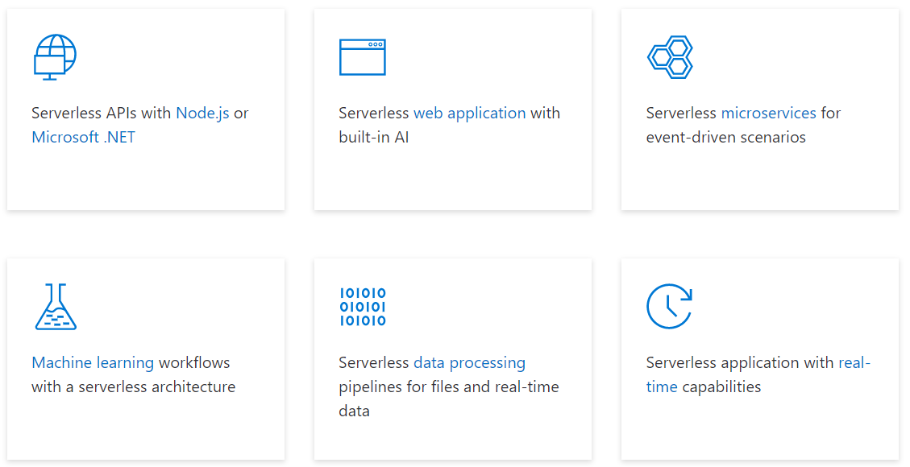
Solutions

